Slide 1

PROJECT ON
Employee Management System

Slide 2



Employee Managament System

Slide 3
Introduction
The Employee Management System (EMS) is designed to streamline the management of employee data, job roles, and departmental information within an organization.
This system allows for efficient tracking of employee details, job assignments, qualifications, and performance metrics. Key domain knowledge elements for this system include:
1. Employee Information Management: The system stores personal details of employees such as name, contact information, gender, and unique login credentials. It is crucial for ensuring secure access and easy retrieval of employee records.
2. Job Role Assignment: Each employee is associated with a specific job role, which is linked to the department they work in. This connection ensures that employees are correctly aligned with their job functions and responsibilities within the organization.

Slide 4
3. Departmental Structure: The organization is divided into various departments (e.g., HR, Finance, IT), each with distinct job roles. The system should manage these departments and the employees assigned to each role efficiently.
4. Payroll and Compensation: Employee compensation details, including salary and bonuses, are stored in the system. Payroll processing and salary allocations are automatically calculated based on the job roles and associated salary ranges.
5. Qualifications and Skills Tracking: The system tracks employee qualifications, certifications, and skills to ensure that employees meet the requirements for their roles and identify opportunities for professional development.
6. Leave and Absence Management: The system manages employee leave records, including vacation days, sick leaves, and other types of absences, with appropriate deductions applied to payroll based on the employee’s leave history.

Slide 5
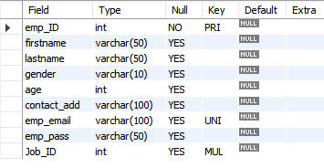
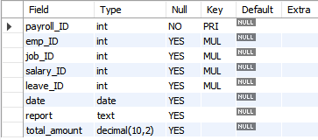
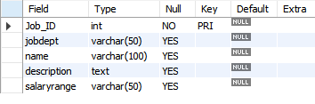
Tables
Employee Table
Payroll Table
JobDepartment Table

Slide 6
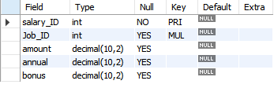
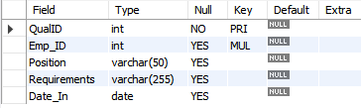

SalaryBous Table
Qualification Table
Leaves Table

Slide 7
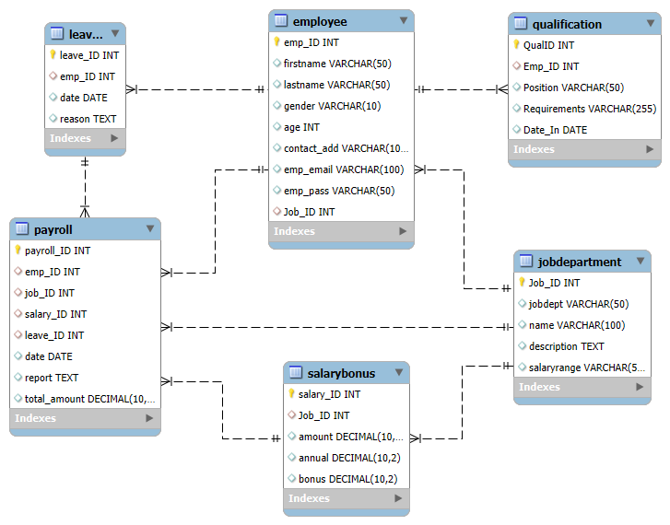
ER Diagram

Slide 8
Problem Statement
The objective of this project is to design and implement an Employee Management System that efficiently stores and manages employee-related data within an organization. The system needs to track various aspects of employee information, including personal details, job roles, salary structures, qualifications, leave records, and payroll data.
The system should ensure the integrity and consistency of data by using relational tables with appropriate foreign keys and cascading actions.
The system should allow for easy management and querying of employee data, providing insights such as payroll calculation, leave tracking, and department-specific job roles. The goal is to streamline HR operations, ensuring that all relevant employee data is accessible and accurately updated across different modules.

Slide 9



Analysis Questions EMPLOYEE INSIGHTS
How many unique employees are currently in the system?

Slide 10
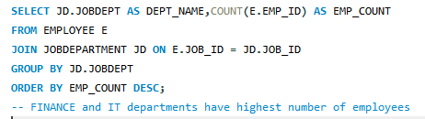
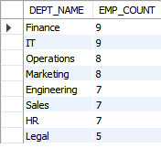

2. Which departments have the highest number of employees?

Slide 11
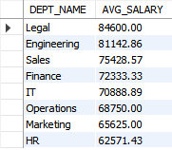
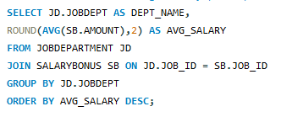

3. What is the average salary per department?

Slide 12
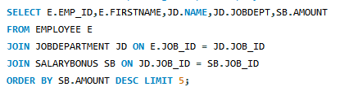

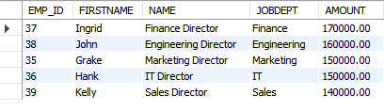
4. Who are the top 5 highest-paid employees?

Slide 13



5. What is the total salary expenditure across the company?

Slide 14
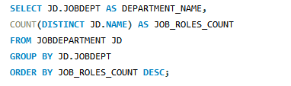
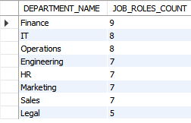

JOB ROLE AND DEPARTMENT ANALYSIS 6. How many different job roles exist in each department?

Slide 15
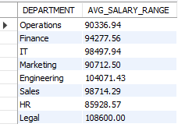
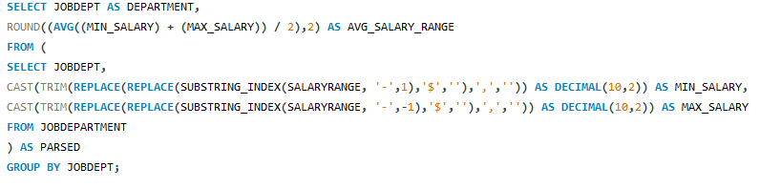
7.What is the average salary range per department?

Slide 16


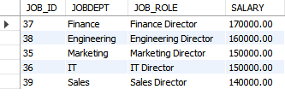
8.Which job roles offer the highest salary?

Slide 17
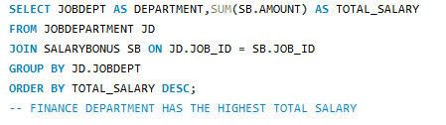
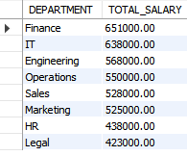

9. Which departments have the highest total salary allocation?

Slide 18



QUALIFICATION AND SKILLS ANALYSIS 10. How many employees have at least one qualification listed?

Slide 19

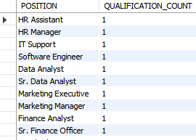

11.Which positions require the most qualifications?

Slide 20
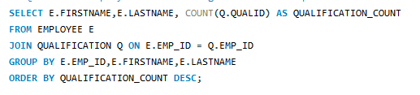
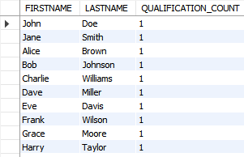

12.Which employees have the highest number of qualifications?

Slide 21

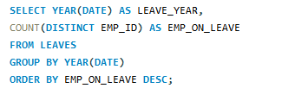

LEAVE AND ABSENCE PATTERNS 13.Which year had the most employees taking leaves?

Slide 22
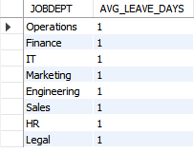
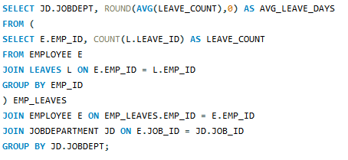
14.What is the average number of leave days taken by its employees per department?

Slide 23
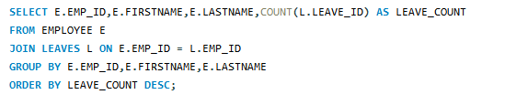
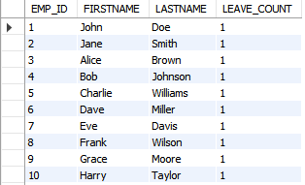

15.Which employees have taken the most leaves?

Slide 24


16.What is the total number of leave days taken company-wide?

Slide 25
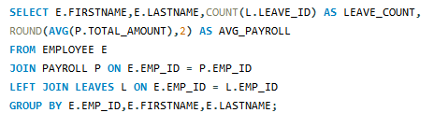
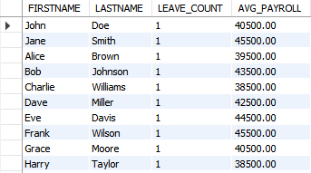

17.How do leave days correlate with payroll amounts?

Slide 26



PAYROLL AND COMPENSATION ANALYSIS 18.What is the total monthly payroll processed?

Slide 27

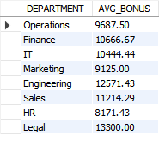

19. What is the average bonus given per department?

Slide 28
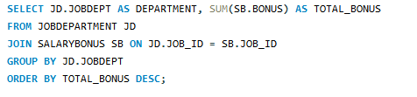
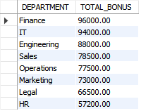

20.Which department receives the highest total bonuses?

Slide 29



21.What is the average value of total_amount after considering leave deductions?

Slide 30

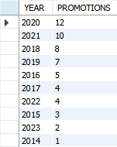

EMPLOYEE PERFORMANCE AND GROWTH 22.Which year had the highest number of employee promotions?

Slide 31

THANK YOU
Group Menbers:
Chiluka Suvarna
Gollapalli Akshitha
Sravani Errolla

